Slide 1

Modules
Python packages
SoftUni Team
Technical Trainers
Software University
http://softuni.bg

Slide 2
Table of Contents
Definition
Where are modules stored?
Why use them?
Built-in modules
External modules
PIP
Custom modules

Slide 3
Have a Question?
sli.do
#python-advanced

Slide 4

What are modules?

Slide 5
What are modules ?
Simply put, a module is a file consisting of Python code
They are stored in packages
A package is a collection of Python modules
Why use modules ?
Keep Python files short and simple
Reuse code across multiple files by importing

Slide 6

Built-in Modules

Slide 7
Definition
The Python interpreter has a number of built-in modules
They are pre-installed and we can call them at any given time
In order to call them we use the keyword - import
import random
fruits = ["apple", "banana", "cherry"]
random.choice(fruits)
random.shuffle(fruits)

Slide 8
Different Ways to Import
import random as module_name
module_name.randint(1, 10)
from random import choice as gimme_one, shuffle as mix
gimme_one(["coke", "steak", "chips"])
mix(["coke", "steak", "chips"])
from math import *
sqrt(pi)

Slide 9
Problem: Calculate Logarithm
Write a program that prints the calculated logarithm of any given number
You will receive 2 inputs
The number (integer)
The base (if it is the word "natural" find the natural logarithm)
Format the result up to the 2nd decimal digit and print it
10
natural
2.30

Slide 10
Solution: Calculate Logarithm
from math import log number = int(input()) base = input() if base == "natural": print(f"{log(number):.2f}") else: print(f"{log(number, int(base)):.2f}")

Slide 11

External Modules
PIP

Slide 12
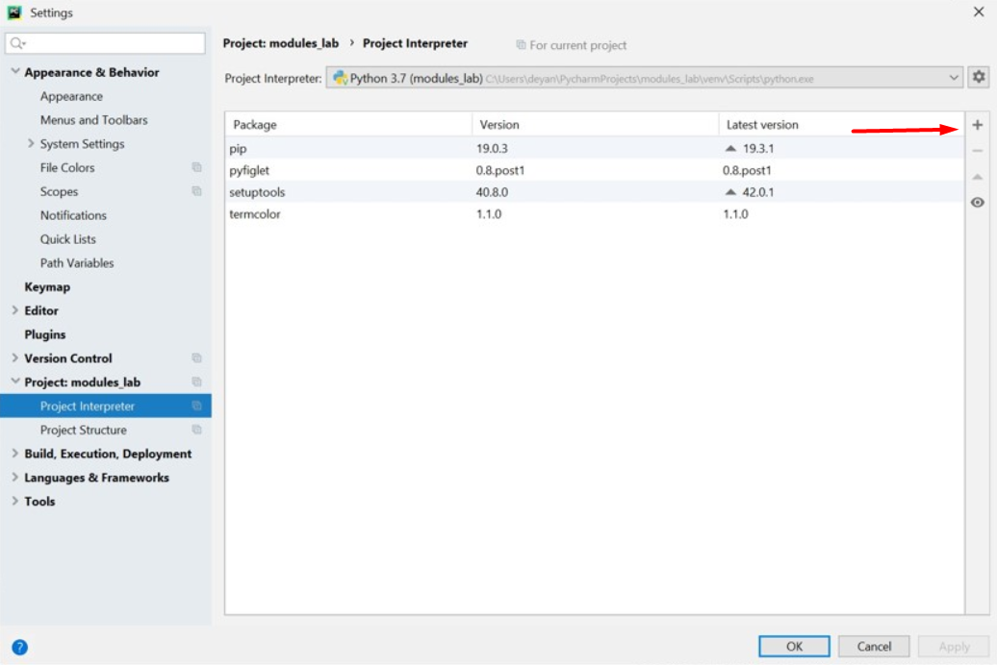
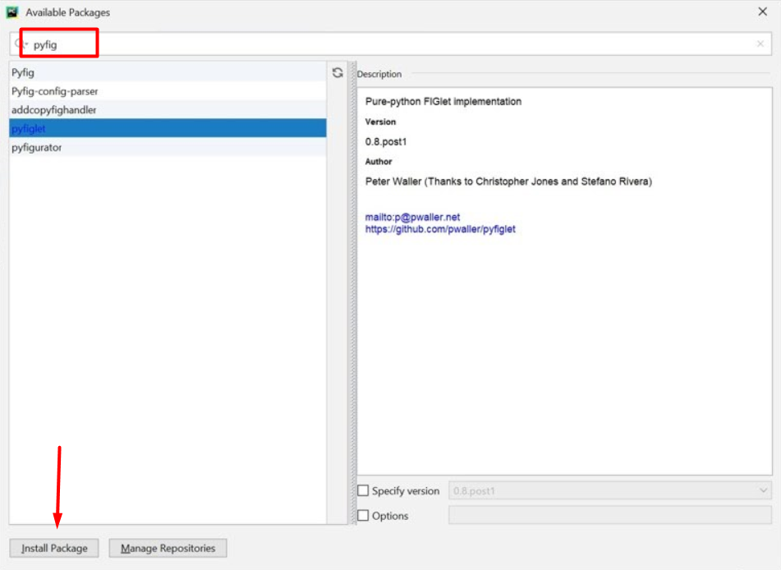
Package Management System (PIP)
External modules are downloaded from the internet by using pip
In PyCharm you have pip already installed, so you can jump straight to installing them

Slide 13
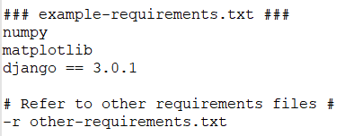
Requirements files
А Requirements file is just a list of pip install arguments placed in a file
You should not rely on the items in the file being installed by pip in any particular order

Slide 14
Requirements files – common uses
Тhere are 4 common uses of Requirements files:
hold the result from pip freeze
force pip to properly resolve dependencies
force pip to install an alternate version of a sub-dependency
override a dependency with a local patch that lives in version control

Slide 15
Some External Modules
Termcolor
PyFiglet
from termcolor import colored text = colored('Hello World!', 'red', attrs=['bold', 'underline']) print(text) # Hello World!
from pyfiglet import figlet_format
text =figlet_format("Python",font="isometric1")
print(text)

Slide 16
Problem: ASCII Art
Using the pyfiglet package, write a program that encrypts given words by using the characters: "-|_/\()" to structure the word
from pyfiglet import figlet_format def print_art(msg): ascii_art = figlet_format(msg) print(ascii_art) msg = input("What would you like to print? ") print_art(msg)

Slide 17

Custom Modules

Slide 18
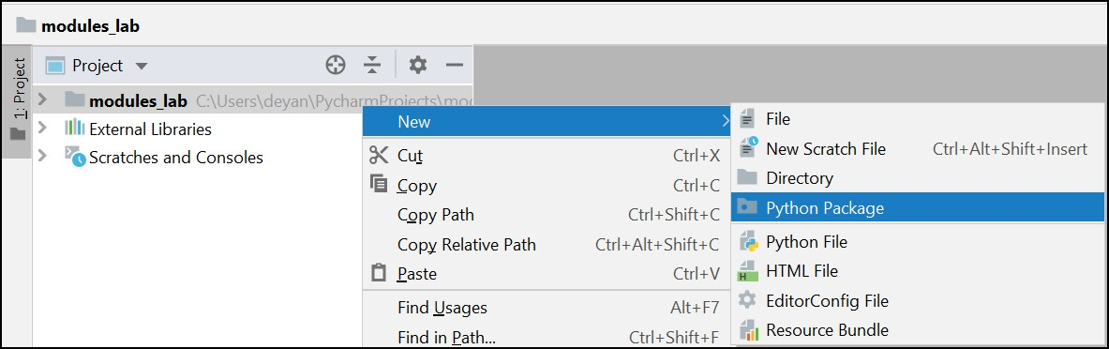
Creating a module (Through PyCharm)
Any .py file can be imported and used as a module
In PyCharm there is a separate option to create a package(module)

Slide 19
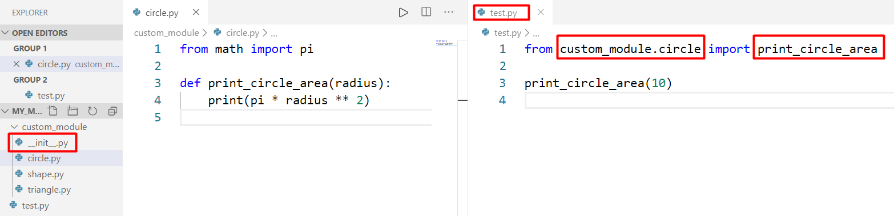
The __init__ file in a module
You can make any folder a module by just adding an __init__ file in the folder
The file can be empty

Slide 20
Problem: Triangle
Create a module for printing a triangle
You will receive an integer number which is the size of the triangle
1
1 2
1 2 3
1 2 3 4
1 2 3
1 2
1
1
1 2
1 2 3
1 2
1
3
4

Slide 21
Solution: Triangle
def print_triangle(size):
for row in range(1, size + 2):
print(*[col for col in range(1, row)])
for row in range(size, 0, -1):
print(*[col for col in range(1, row)])
from triangle import * size = int(input()) print_triangle(size)

Slide 22

Practice
Live Exercise in Class (Lab)

Slide 23

Summary
A module is a file consisting of Python code
There are a couple of ways to import a module:
Modules make our code short, simple and reusable
import <module_name>
from <module_name> import <module_attribute>
import <module_name> as <custom_name>

Slide 24
Questions?
Notes:
24

Slide 25












SoftUni Diamond Partners

Slide 26


Educational Partners

Slide 27

License
This course (slides, examples, demos, exercises, homework, documents, videos and other assets) is copyrighted content
Unauthorized copy, reproduction or use is illegal
© SoftUni – https://about.softuni.bg
© Software University – https://softuni.bg
Notes:
27

